Slide 1
Social network project
VK EgoNet analysis
Student: Rudenkov Dmitriy
Group: DS2022
Date: 30.04.2023

Slide 2

VK EgoNet analysis
The aim of the project is to provide descriptive analysis of a social network.
In this work, I considered the ego network of social relationships of my friends in the social service VK.
Main parts of work:
Parsing data from VK
Network summary
Structural Analysis
Community Detection

Slide 3
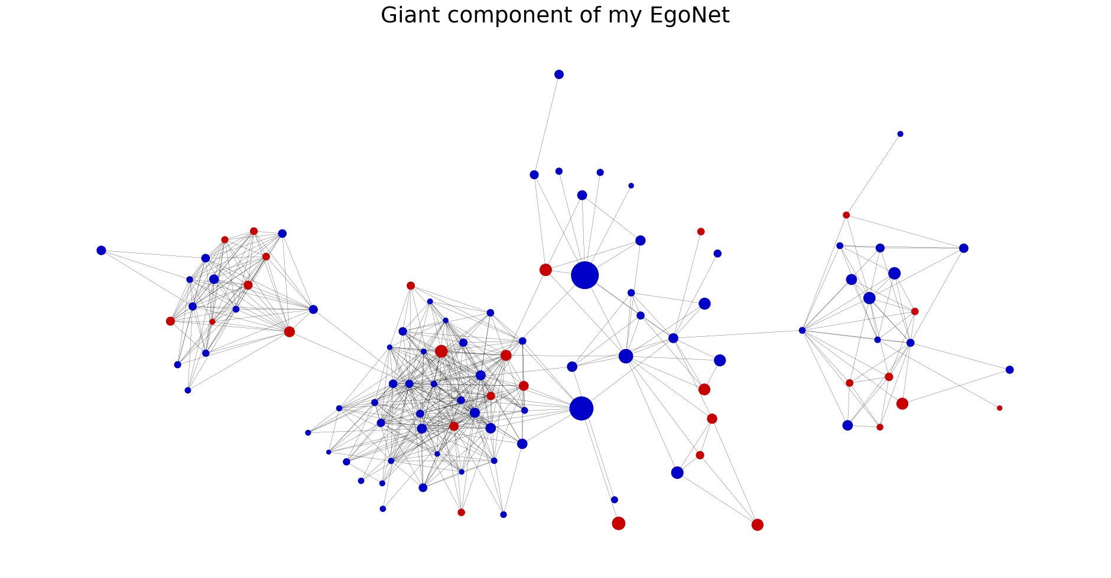
Network summary
EGO NET:
Number of nodes: 138
Number of edges: 626
Average degree: 9.07
Average clustering coefficient: 0.59
Global clustering coefficient: 0.61
GIANT SUBGRAPH:
Number of nodes: 104
Number of edges: 562
Average degree: 10.81
Radius: 4
Diameter: 8
Average shortest path length: 3.37
Average clustering coefficient: 0.65
Global clustering coefficient: 0.60

Slide 4
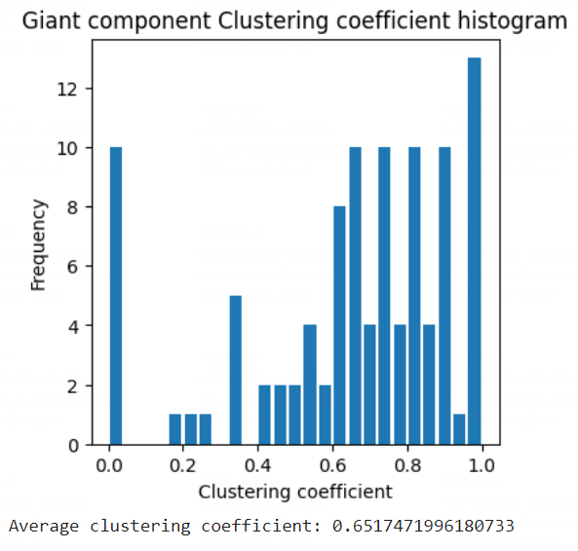
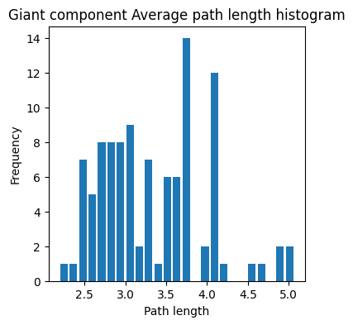
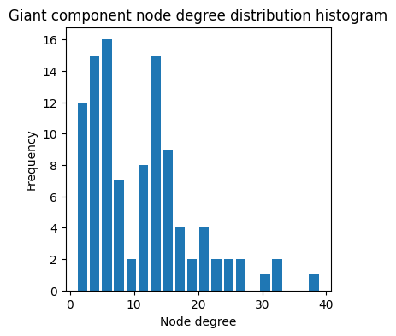
Network summary

Slide 5
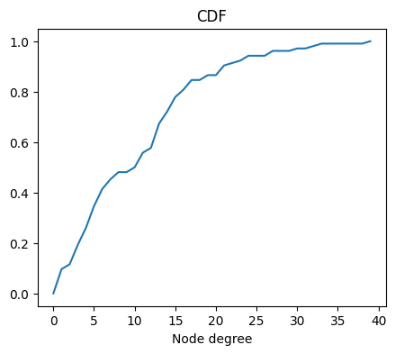
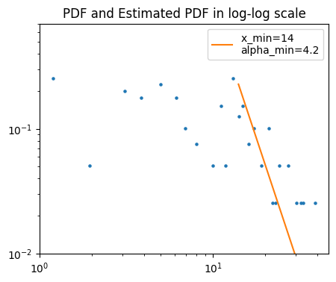
PDF and CDF

Slide 6
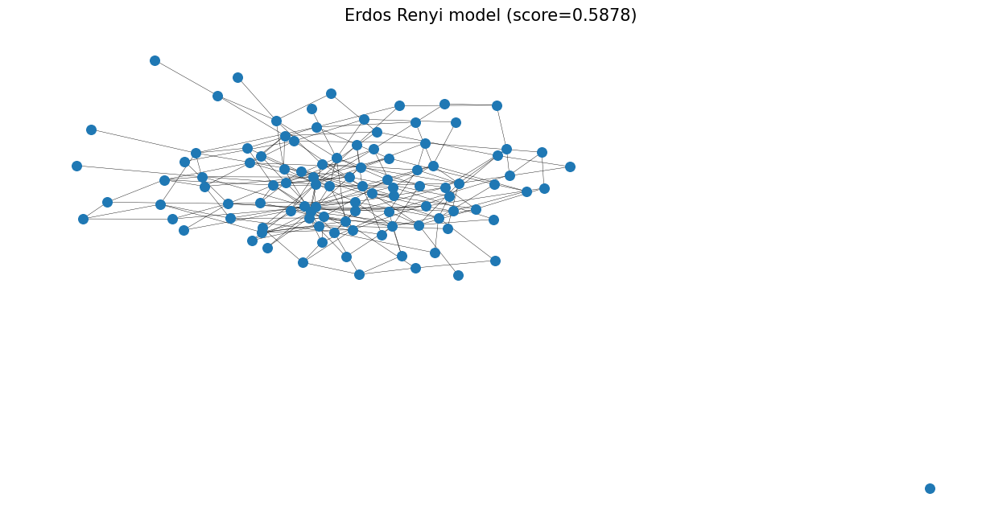
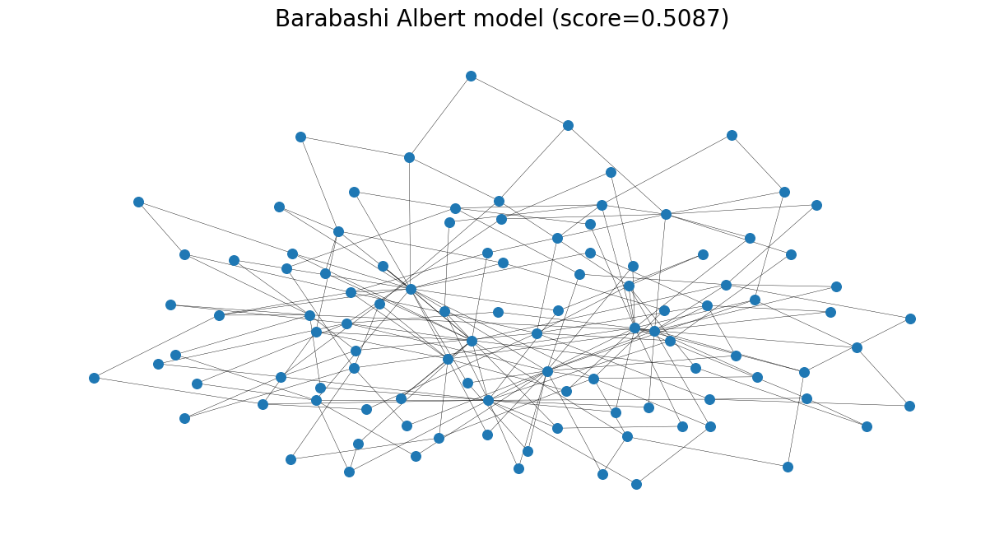
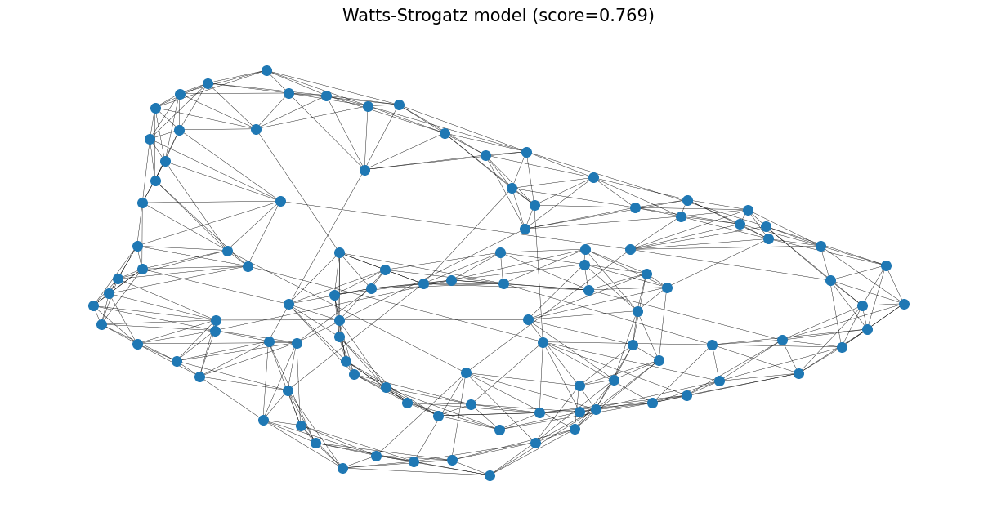
The closest random graph model similar to our social network
In our case, we got the best parameters from the Watts-Strogatz model, which is more or less expected since our graph is quite small and closer in characteristics to small-world properties(path lengths, high clustering).

Slide 7
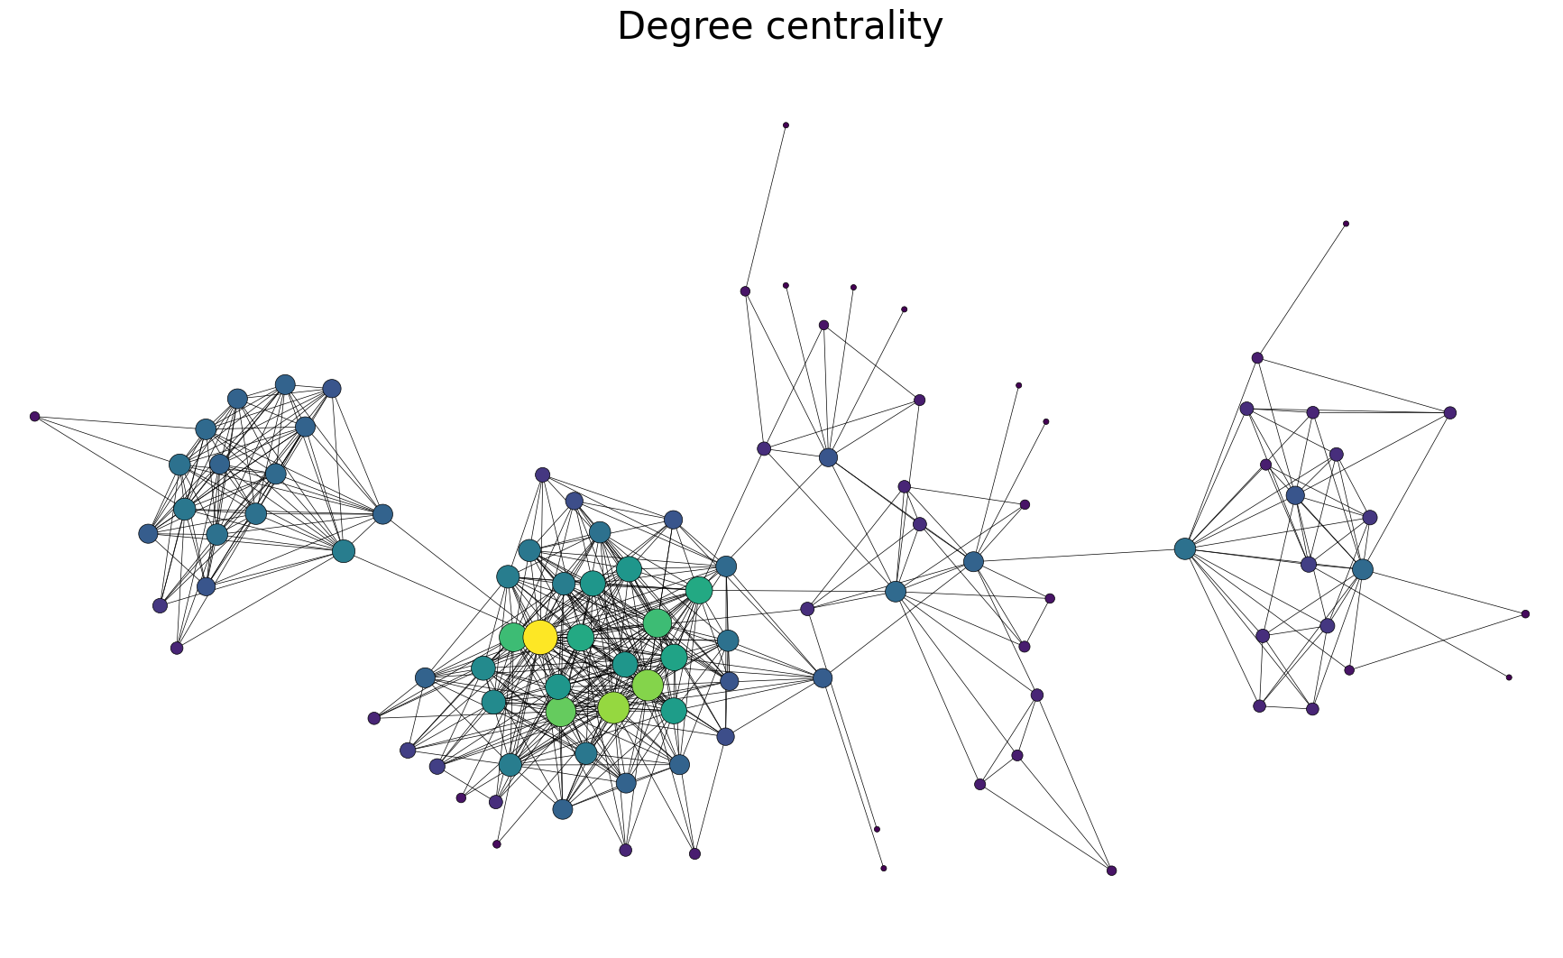
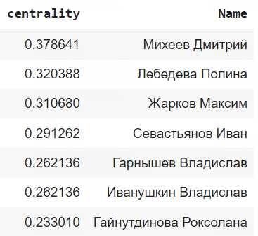
Degree centrality

Slide 8
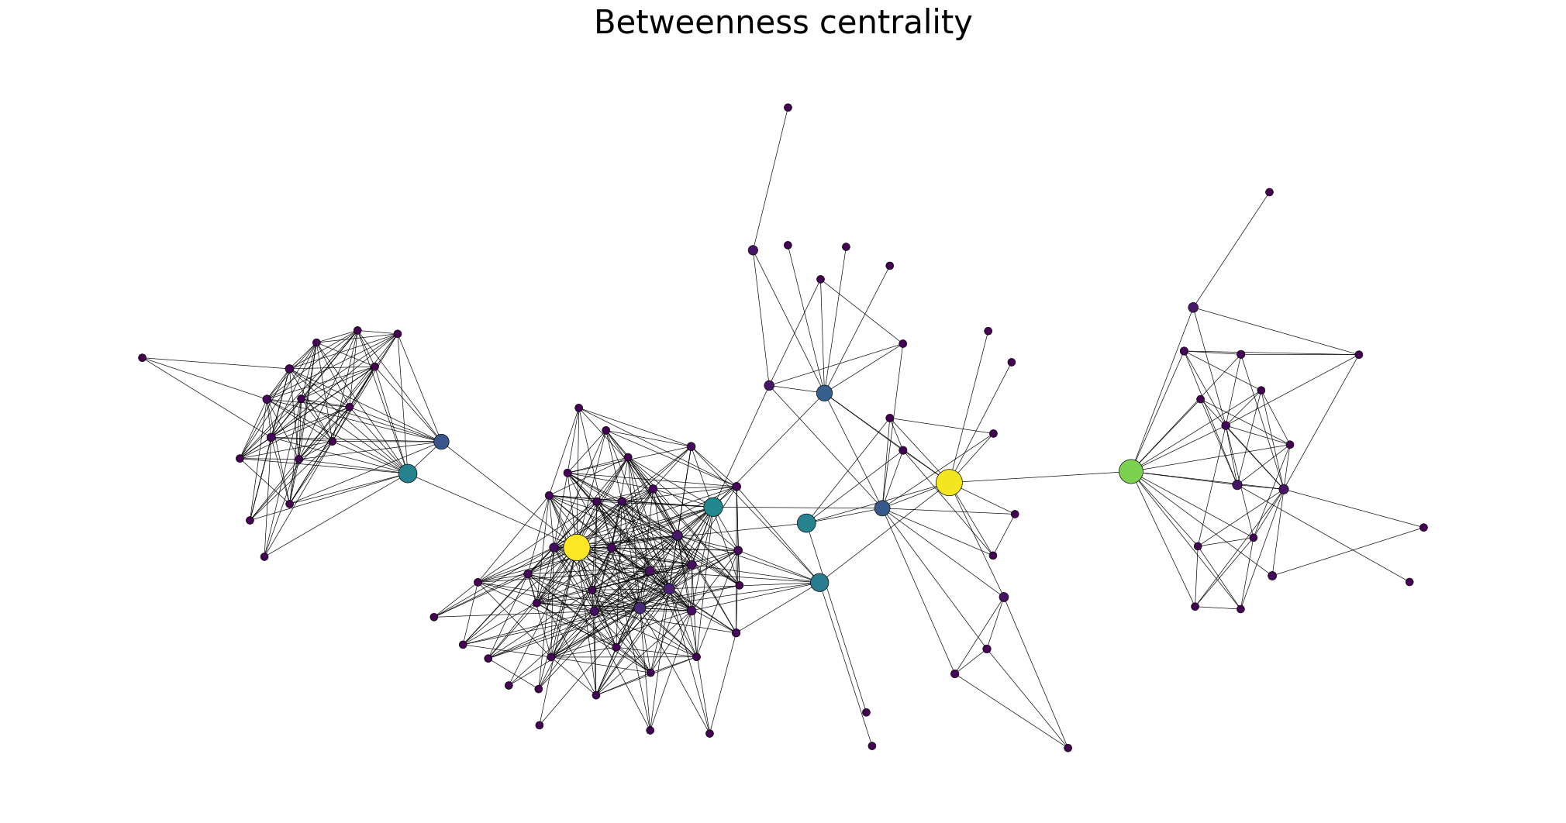
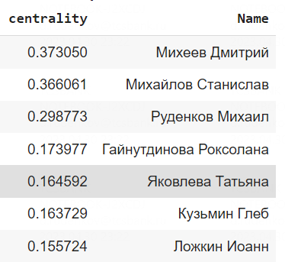
Betweenness centrality

Slide 9
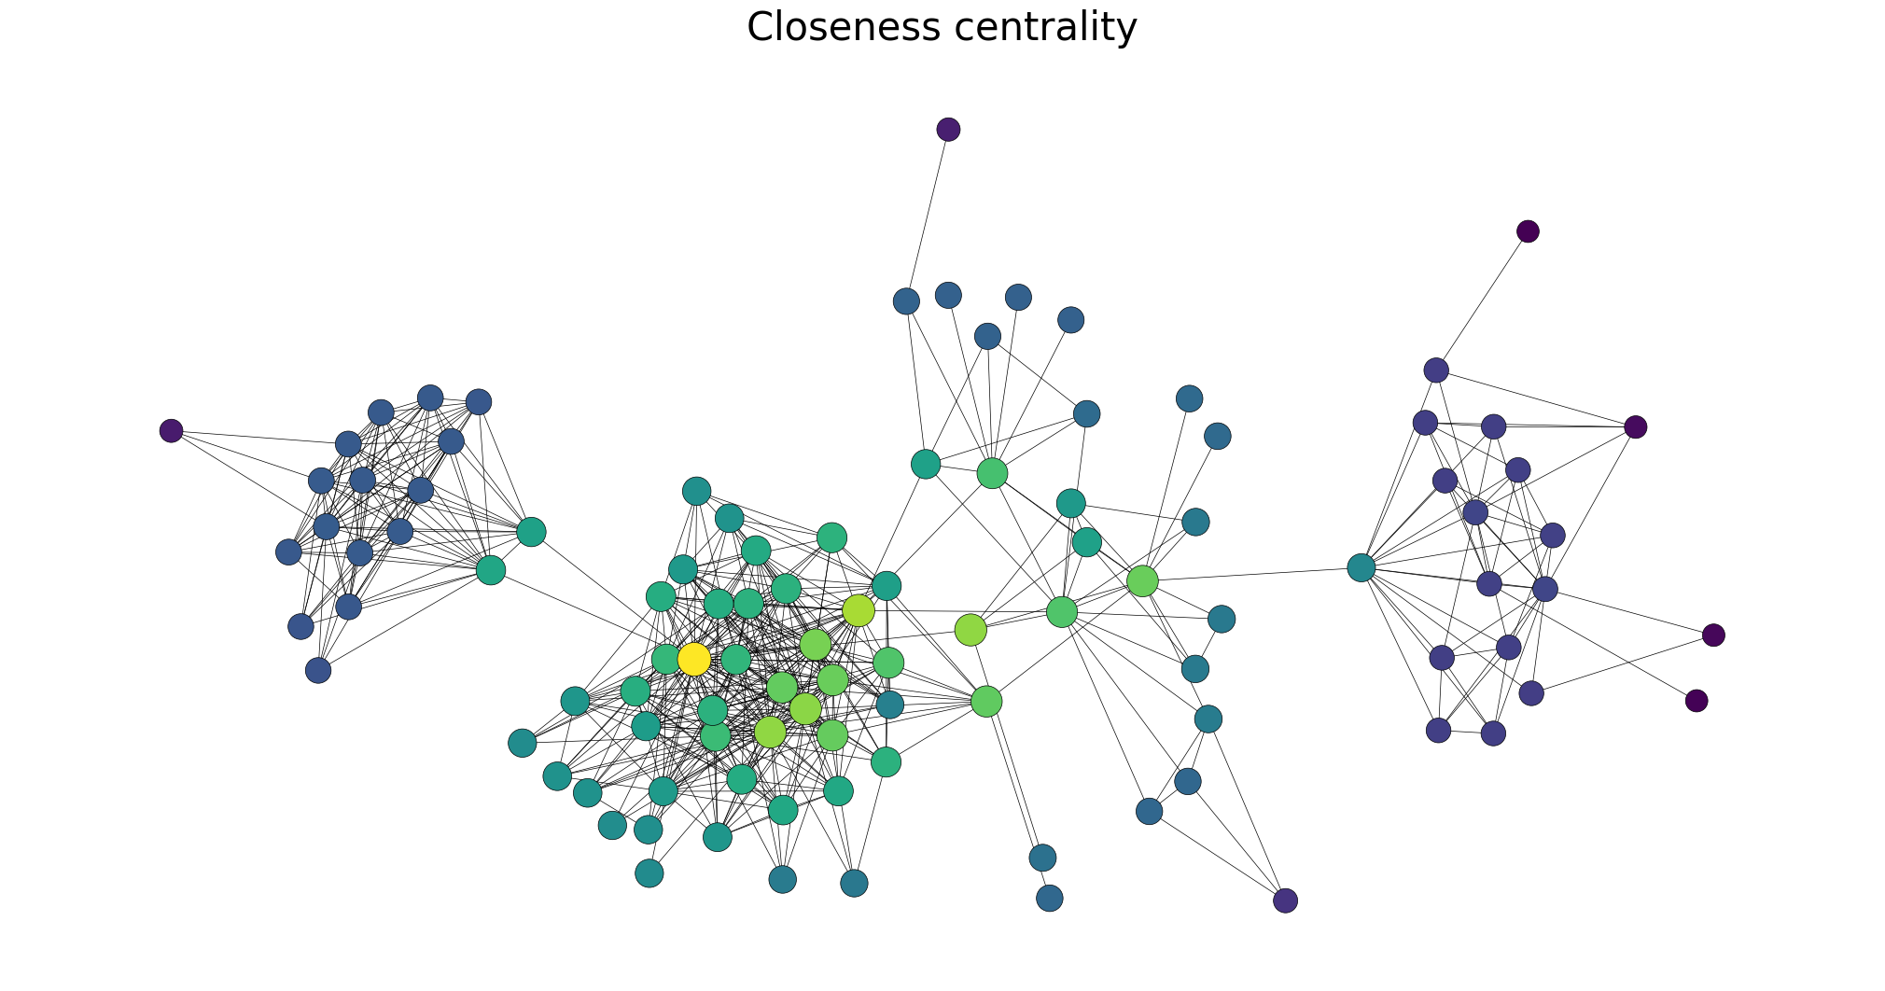
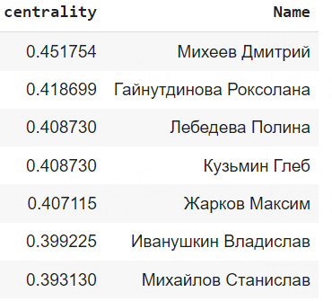
Closeness centrality

Slide 10
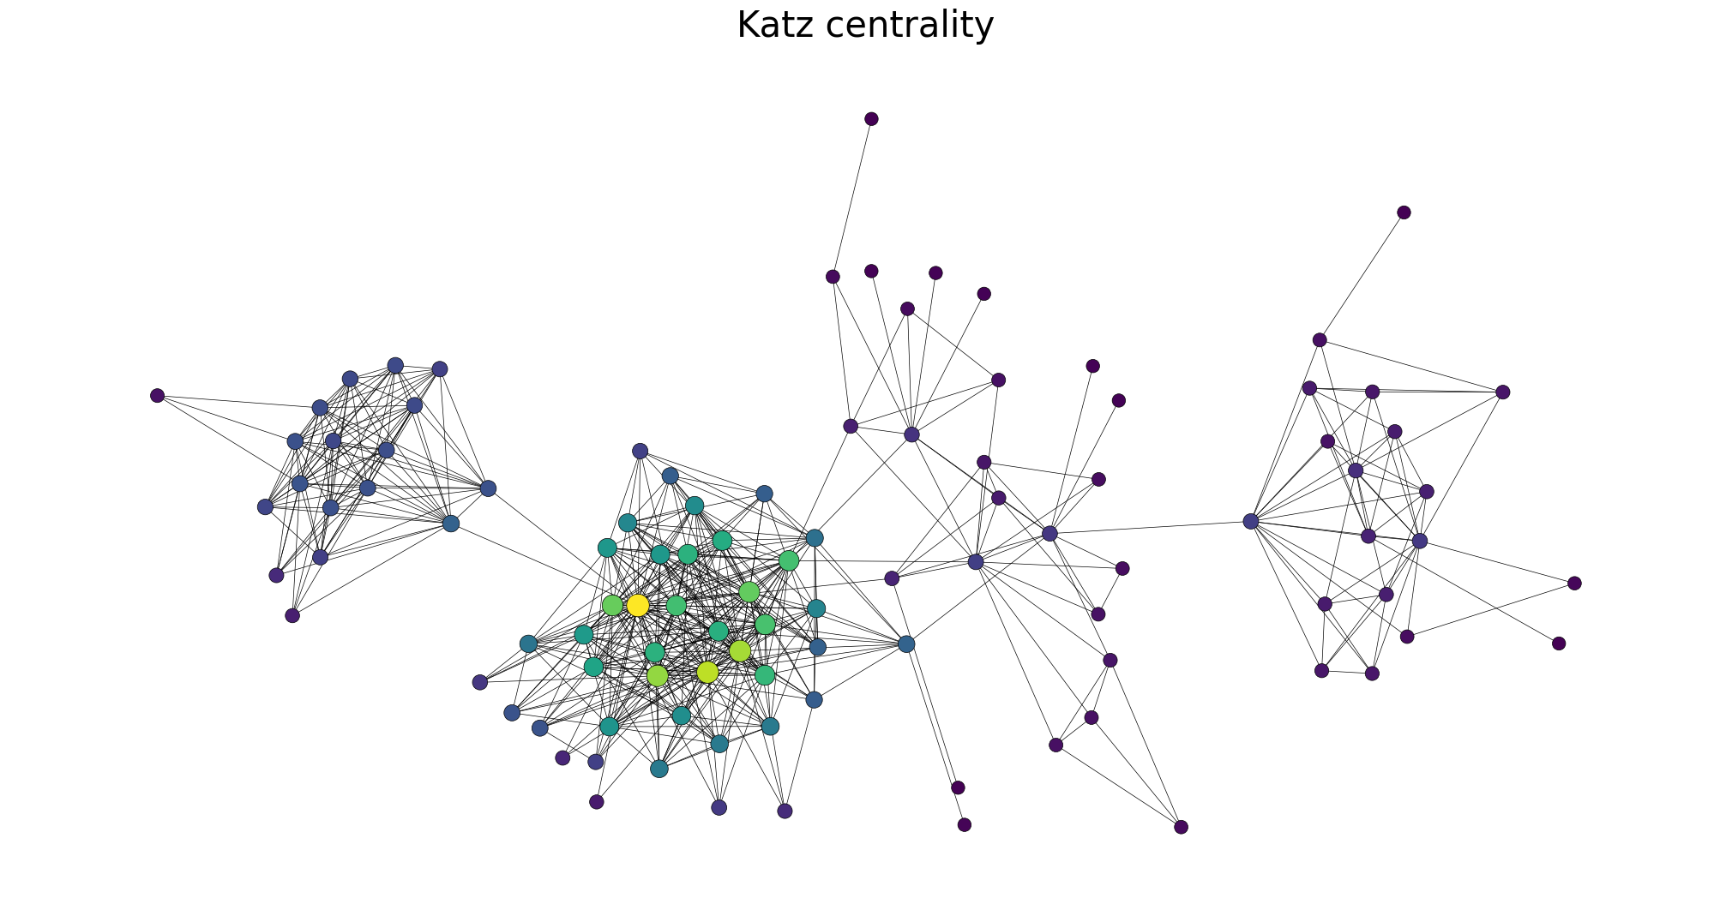
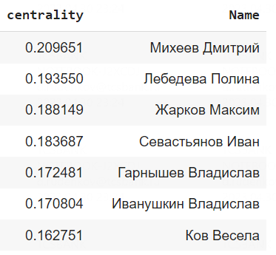
Katz centrality

Slide 11
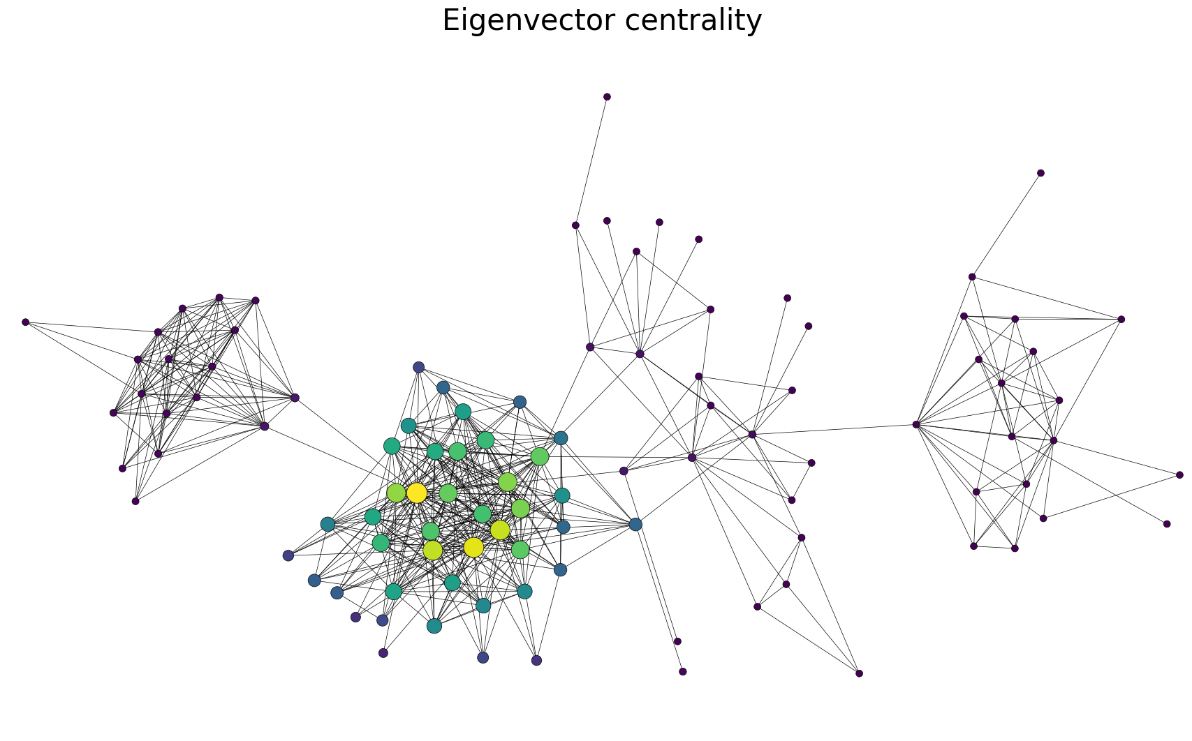
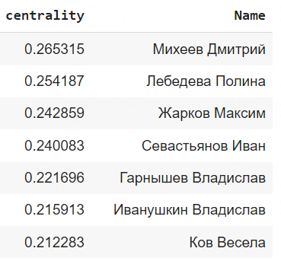
Eigenvector centrality

Slide 12
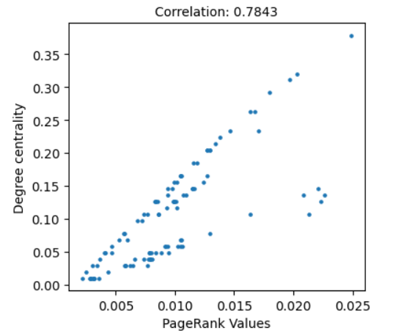
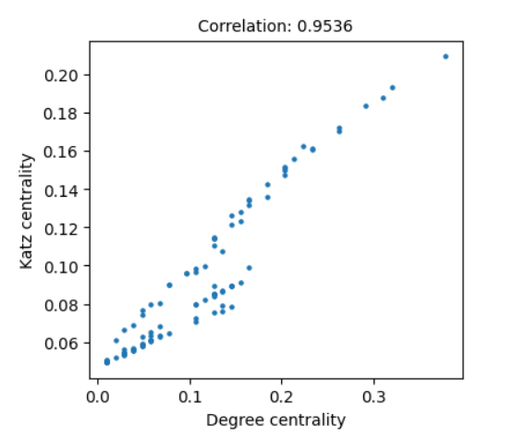
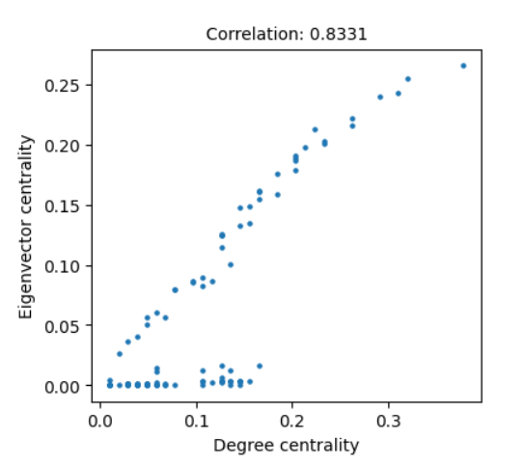
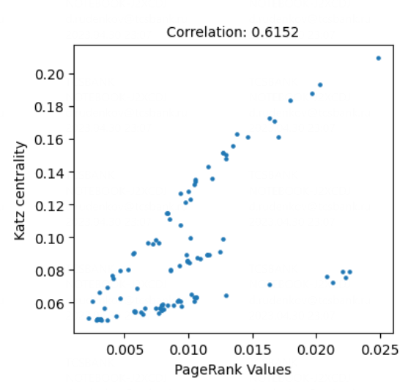
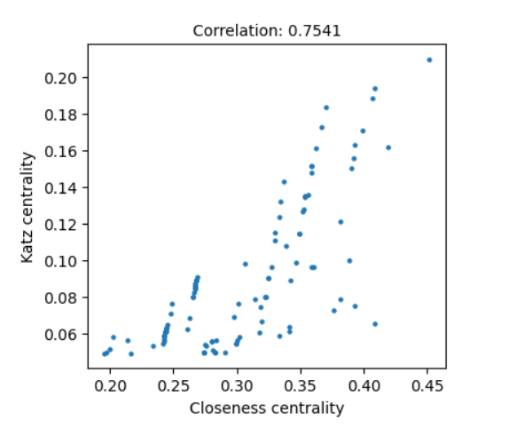
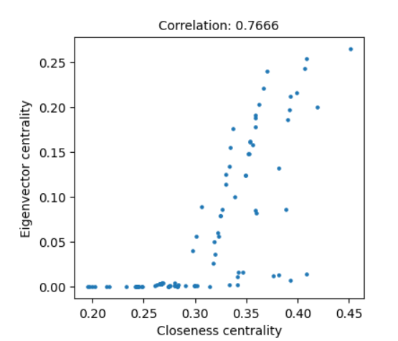
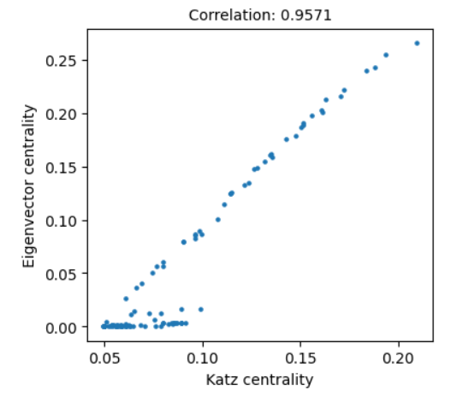
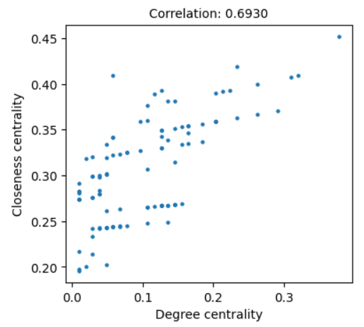
Comparison of centralities

Slide 13
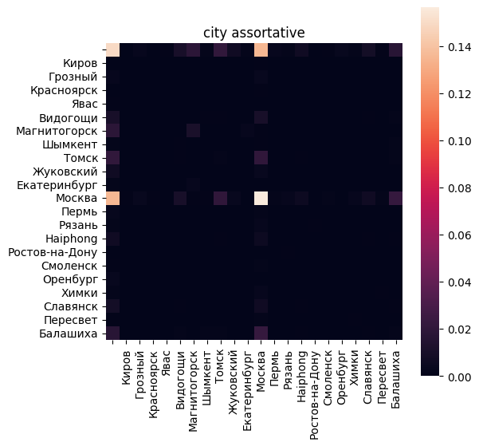
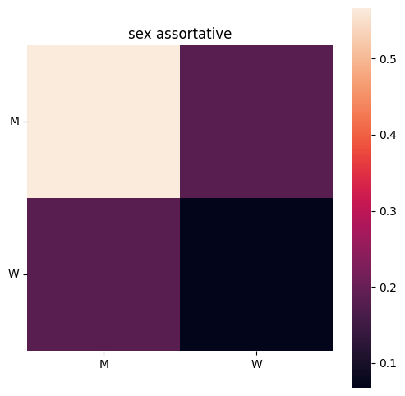
Assortative mixing by node attributes and node degree

Slide 14
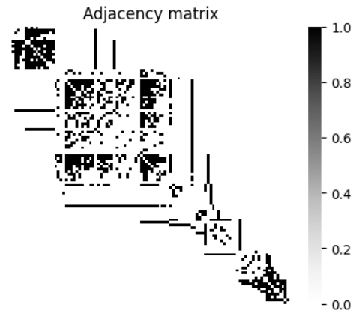
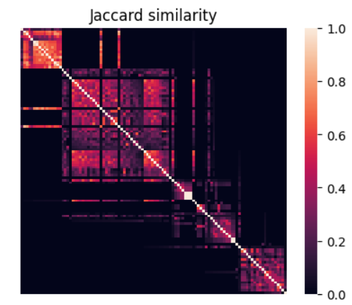
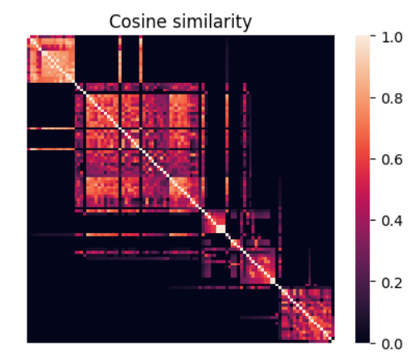
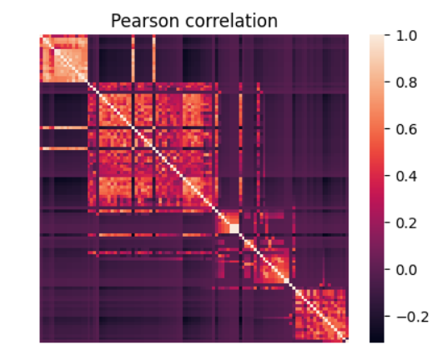
Node structural equivalence/similarity

Slide 15
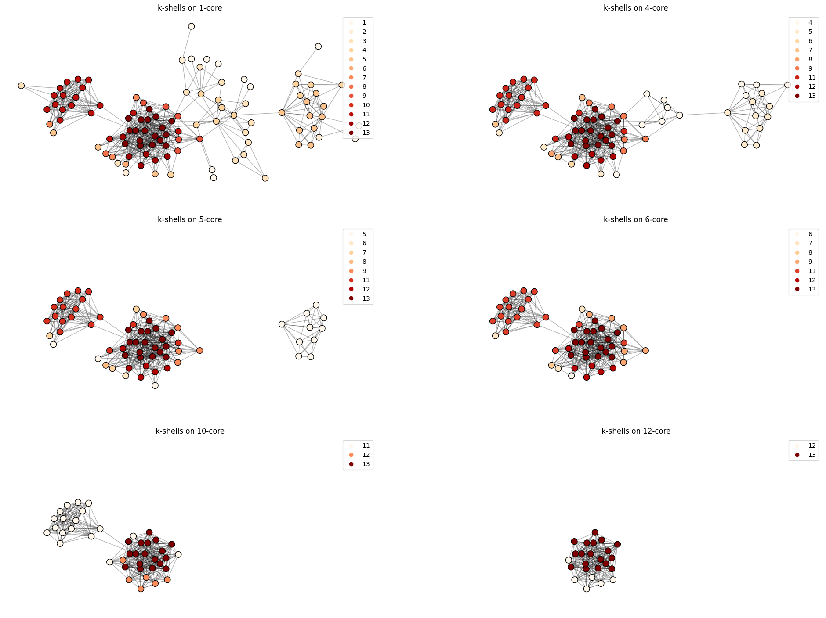
k-cores visualization
A k-core is the largest subgraph such that each vertex is connected to at least k others in subset.
Every vertex in k-core has a degree ki ≥ k (k + 1)-core is always subgraph of k-core The core number of a vertex is the highest order of a core that contains this vertex.

Slide 16
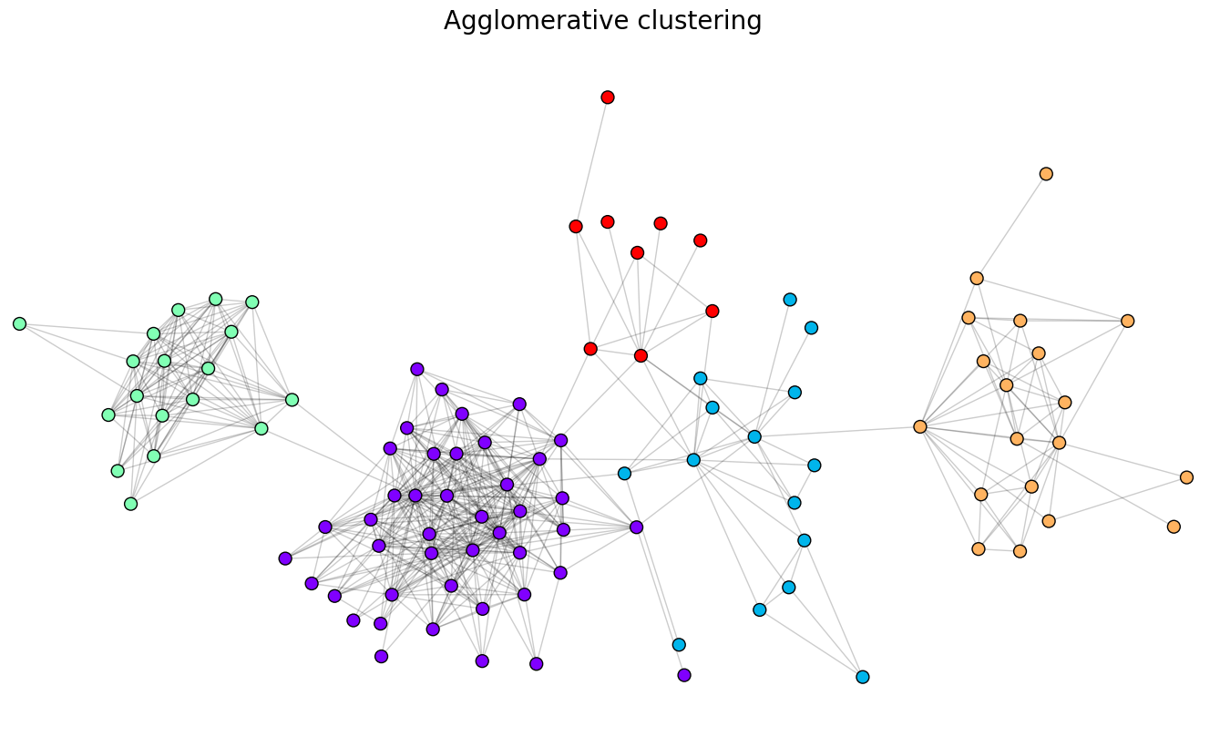
Best results of community detection algorithms
We got a pretty accurate representation of the communities:
Green: HSE magistr community
Purple: BMSTU bachelor students community
Red: Tutor Work community
Blue: Hostel community
Orange: Family and relatives community
Of course, there are certain nodes that fall out of the resulting clustering, but in general, this method coped with the task

